Slide 1
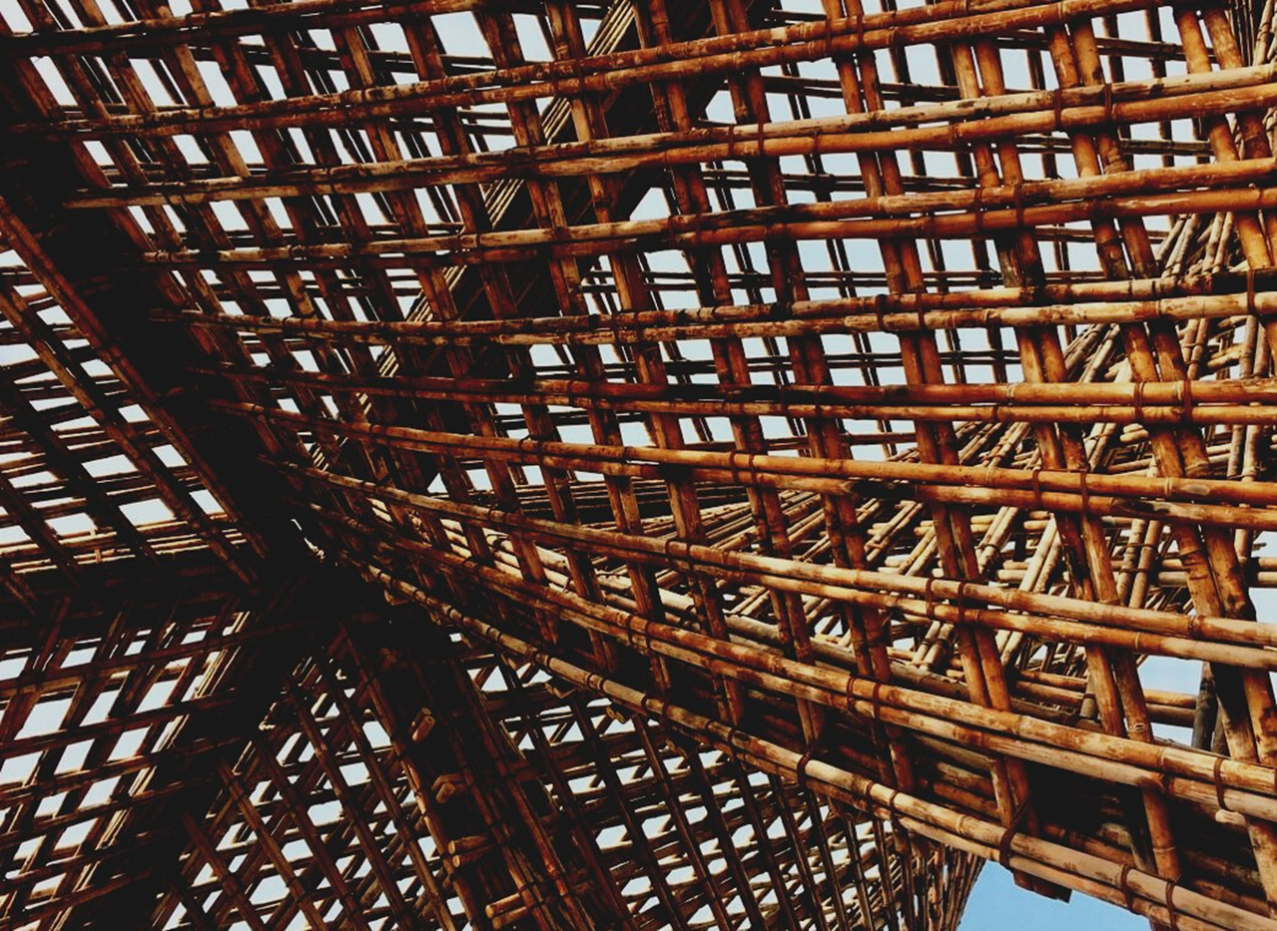
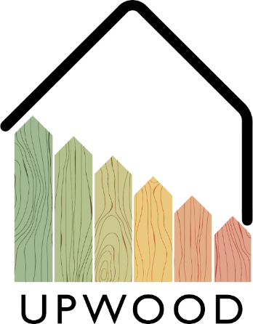
LEARNING UNIT 3: On-site wood construction assembling management.
Lesson 5:
Short Vapor Barrier
Presentation

Slide 2
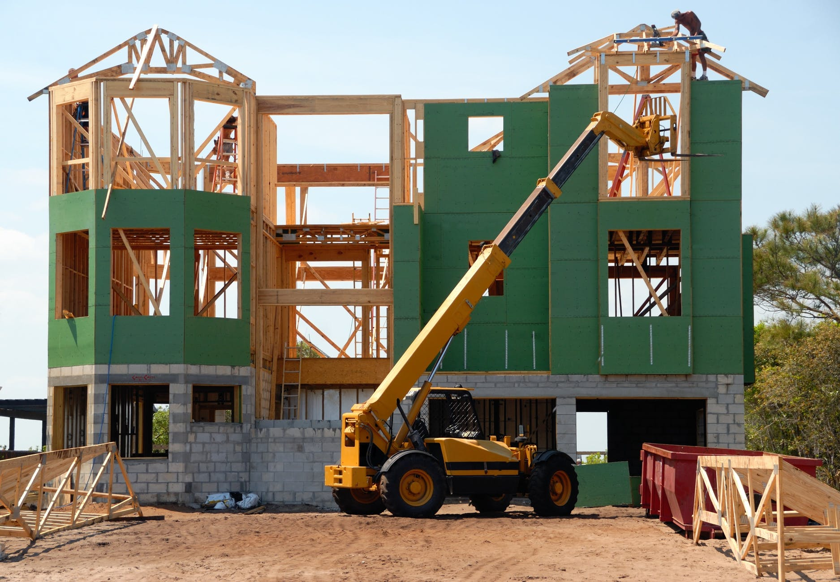
Presentation Overview
TOPICS DISCUSSED
- Short Vapor Barrier.
Materials
Disposition
LESSON 5: Short Vapor Barrier

Slide 3
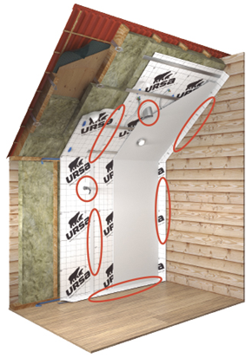
SHORT VAPOUR BARRIER
Wood allowed the passage of air and at the same time absorb a large amount of water, these aspects must be considered during the installation of the short vapor barrier.
The consequences of not considering the behaviour of wood can cause:
- swelling of walls,
-collapse of the building due to the increase of
density of the wood
- problems with the finishing coat and cladding of the walls
- mold at the corner of the building
- deformation of the walls due to cracking and freezing water
- absorption of humidity by the isolation material and consequent destruction of it.
3
LESSON 5: Short Vapor Barrier

Slide 4
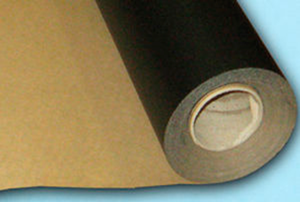
Materials
Polyethylene film
Usually are used with a thickness of 1 mm and are the most simple and cheap option. The downside is the complete blockage of air circulation and walls cannot breathe properly. The use of this materials must be done carefully, and it is not necessary to stretch it when installed.
LESSON 5: Short Vapor Barrier

Slide 5
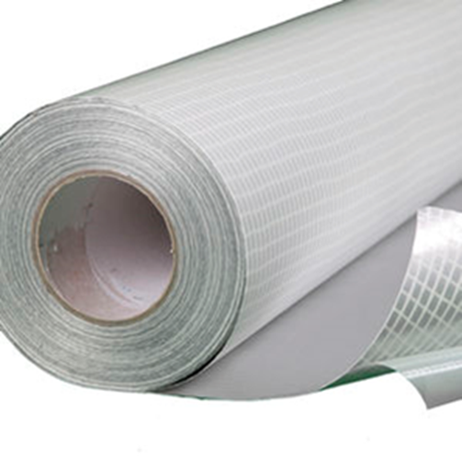
Materials
Film membrane
This could be a very valid option thanks to its characteristics that embodies the ones of the previous materials. This film gives the proper isolation and allows air circulation, it is the most used choice in wood construction. This material offers good behaviour towards condensation and protects against water penetration, can resist huge change temperatures, gives a proper interchange of gases between interior and exterior, the multilayer structure of material usually is reinforced with aluminium paper and this helps the isolation and temperature maintenance during winter.
LESSON 5: Short Vapor Barrier

Slide 6
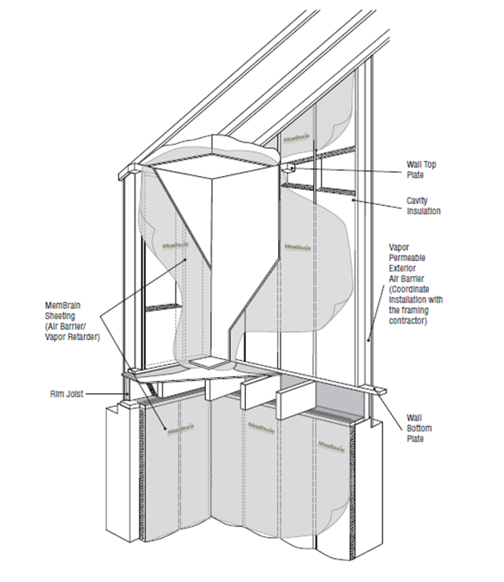
Disposition
The vapor barrier will be disposed according the type of work carried out, in a house the wall is isolated from the interior, in a basement the vapor barrier will be in the exterior and in some peculiar situation the isolation will be carried out in both sides interior and exterior. When the barrier is done externally, the action of cold winds and humidity must be taken in account, providing a sheet that supports that.
LESSON 5: Short Vapor Barrier

