Slide 1
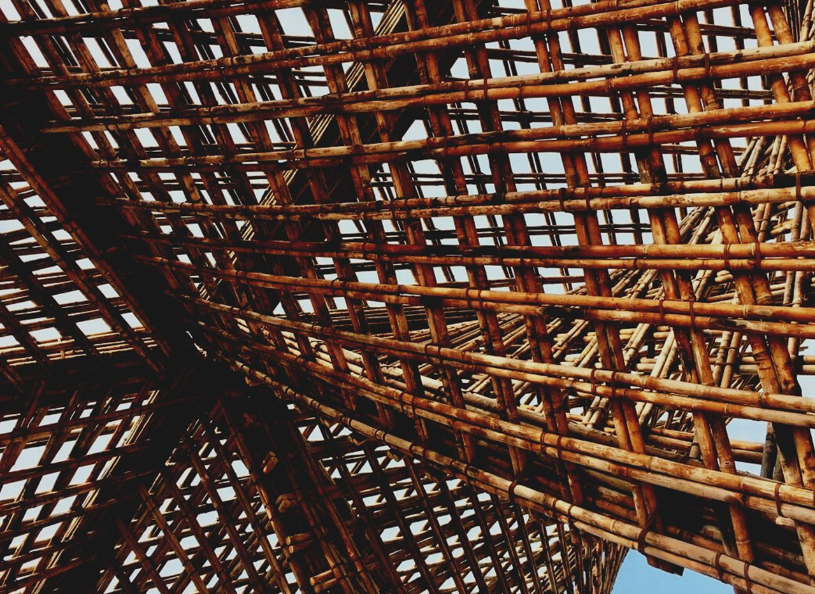
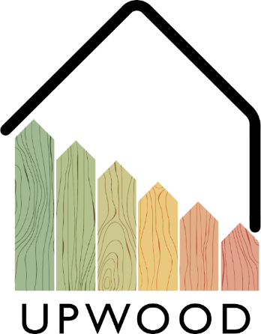
LEARNING UNIT 4: Functionality and efficiency of wooden buildings / Learning unit 4 (LU4)
Lesson 3:
Trainings for plumbing, drywall construction, sealing.
Presentation

Slide 2
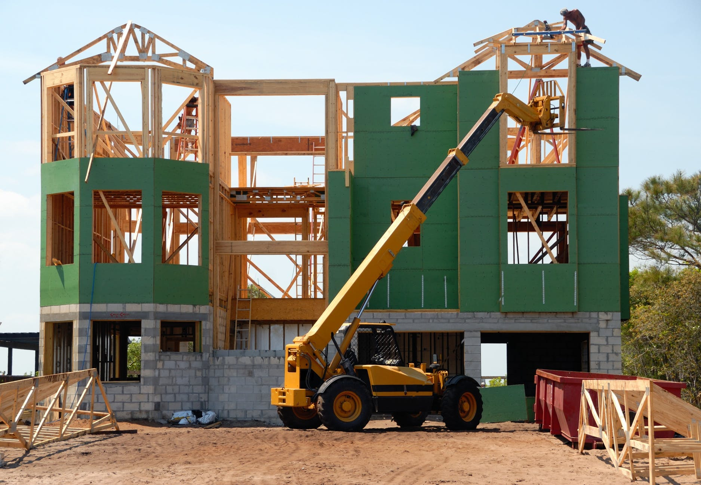
Presentation Overview
TOPICS DISCUSSED
- Plumbing
- Dry construction and seal system
LESSON 3:Trainings for plumbing, drywall construction, sealing.

Slide 3
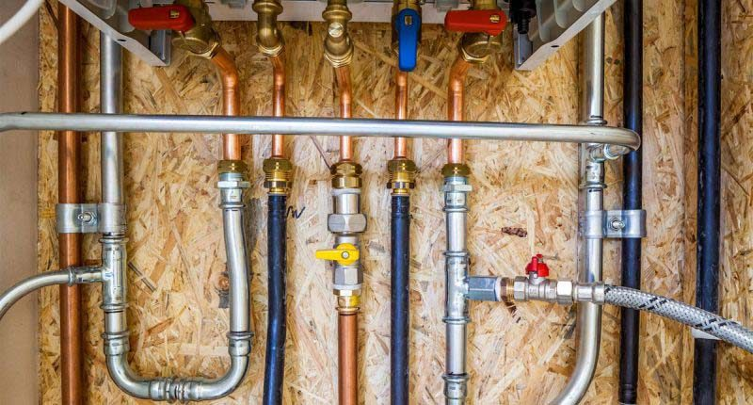
PLUMBING
In order to provide an adequate supply of water, it is important to be aware of the properties of the pipes that are installed in each building, assuring a minimum set of conditions for the provided water, such as potability, endurance against corrosion, temperature fluctuation resistance, and enough flow and pressure.
3
LESSON 3:Trainings for plumbing, drywall construction, sealing.

Slide 4
Topics to consider
Renewable energy contribution to water heating.
The installation of thermal solar panels is a very sustainable system that can assist to the heating processes proving every building with a minimum amount of low energy-cost hot water,
Cold water supply
In most cases, the water should be provided from an urban distribution network, where the building piping network is connected, providing water to the whole building
Sanitation
Aside of the clean water supply, it is really important to project an adequate sanitation network, in order to evacuate all the dirty water from inside the dwellings, as well as the rainwater from the roof and terraces.
Hot water supply.
Every dwelling must be provided with domestic hot water, with a private heating system installed inside the dwelling, or through a common heating system for the whole building, or even with a public supply of hot water.
Materials
The used materials for the pipes can be metallic, made from cement components, or plastic, being several different specific variations of each material to be used, where the most common ones are made metallic or plastic.
LESSON 3:Trainings for plumbing, drywall construction, sealing.

Slide 5
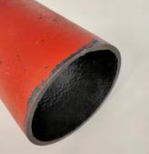
Pipes materials
Cast Iron pipes
PVC-U
PVC-C
Steel pipes
Polyethylene Pipes
Stainless steel pipes
PEX/PER Polyethylene
Galvanized steel
Polypropylene
Cupper pipes
Polybutylene
Multilayer composite pipes
5
LESSON 3:Trainings for plumbing, drywall construction, sealing.

Slide 6
DRY CONSTRUCTION AND SEAL SYSTEM
Nowadays, the different types of industrial facade closures, such as light systems consisting of metal and wood panels, prefabricated plaster panels and the different curtain wall constructions, constitute a technological alternative and economically competitive alternative compared to traditional closures, built from various sections of ceramic brickwork or concrete.
This type of industrialized construction system to guarantee their stability and strength needs a support structure that has its anchoring and fixing elements.
6
LESSON 3:Trainings for plumbing, drywall construction, sealing.

Slide 7
Topics to consider
Renewable energy contribution to water heating.
The installation of thermal solar panels is a very sustainable system that can assist to the heating processes proving every building with a minimum amount of low energy-cost hot water,
Sanitation
Aside of the clean water supply, it is really important to project an adequate sanitation network, in order to evacuate all the dirty water from inside the dwellings, as well as the rainwater from the roof and terraces.
Materials
The used materials for the pipes can be metallic, made from cement components, or plastic, being several different specific variations of each material to be used, where the most common ones are made metallic or plastic.
LESSON 3:Trainings for plumbing, drywall construction, sealing.

Slide 8
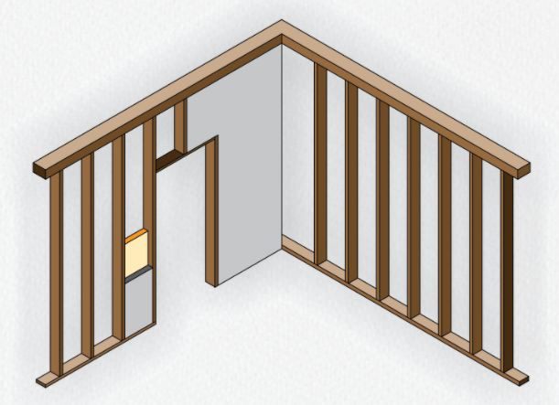
Panels
The panels constitute the element that gives the external appearance of the closure depending on the texture, the colour and texture chosen.
Elements
Auxiliar Structure
The auxiliar structure is the one transmitting the efforts that they receive, mainly their own weight and the action of the wind, to the load bearing structure of the building.
Insulation
In most of cases, in order to provide the best hydrothermal and thermal conditions to the wall composition, some insulation material is disposed between the frames.
LESSON 3:Trainings for plumbing, drywall construction, sealing.

Slide 9
Advantages of dry construction
LOW WEIGHT
CONSTRUCTION SPEED
Either because the materials that make up the panels and elements of the auxiliary structure are light, either because they can achieve the necessary stiffness with little thickness
The panels are manufactured in a workshop, while other operations are carried out “in situ”. When they arrive at work, they are assembled with dry systems.
QUALITY
LARGE POSSIBILITIES
High quality control and homogeneity of the product as it is manufactured in industrial installations.
Large plastic possibilities, with a wide range of finishing materials, shapes, dimensions, of superficial textures and of colours.
LESSON 3:Trainings for plumbing, drywall construction, sealing.

