Slide 1
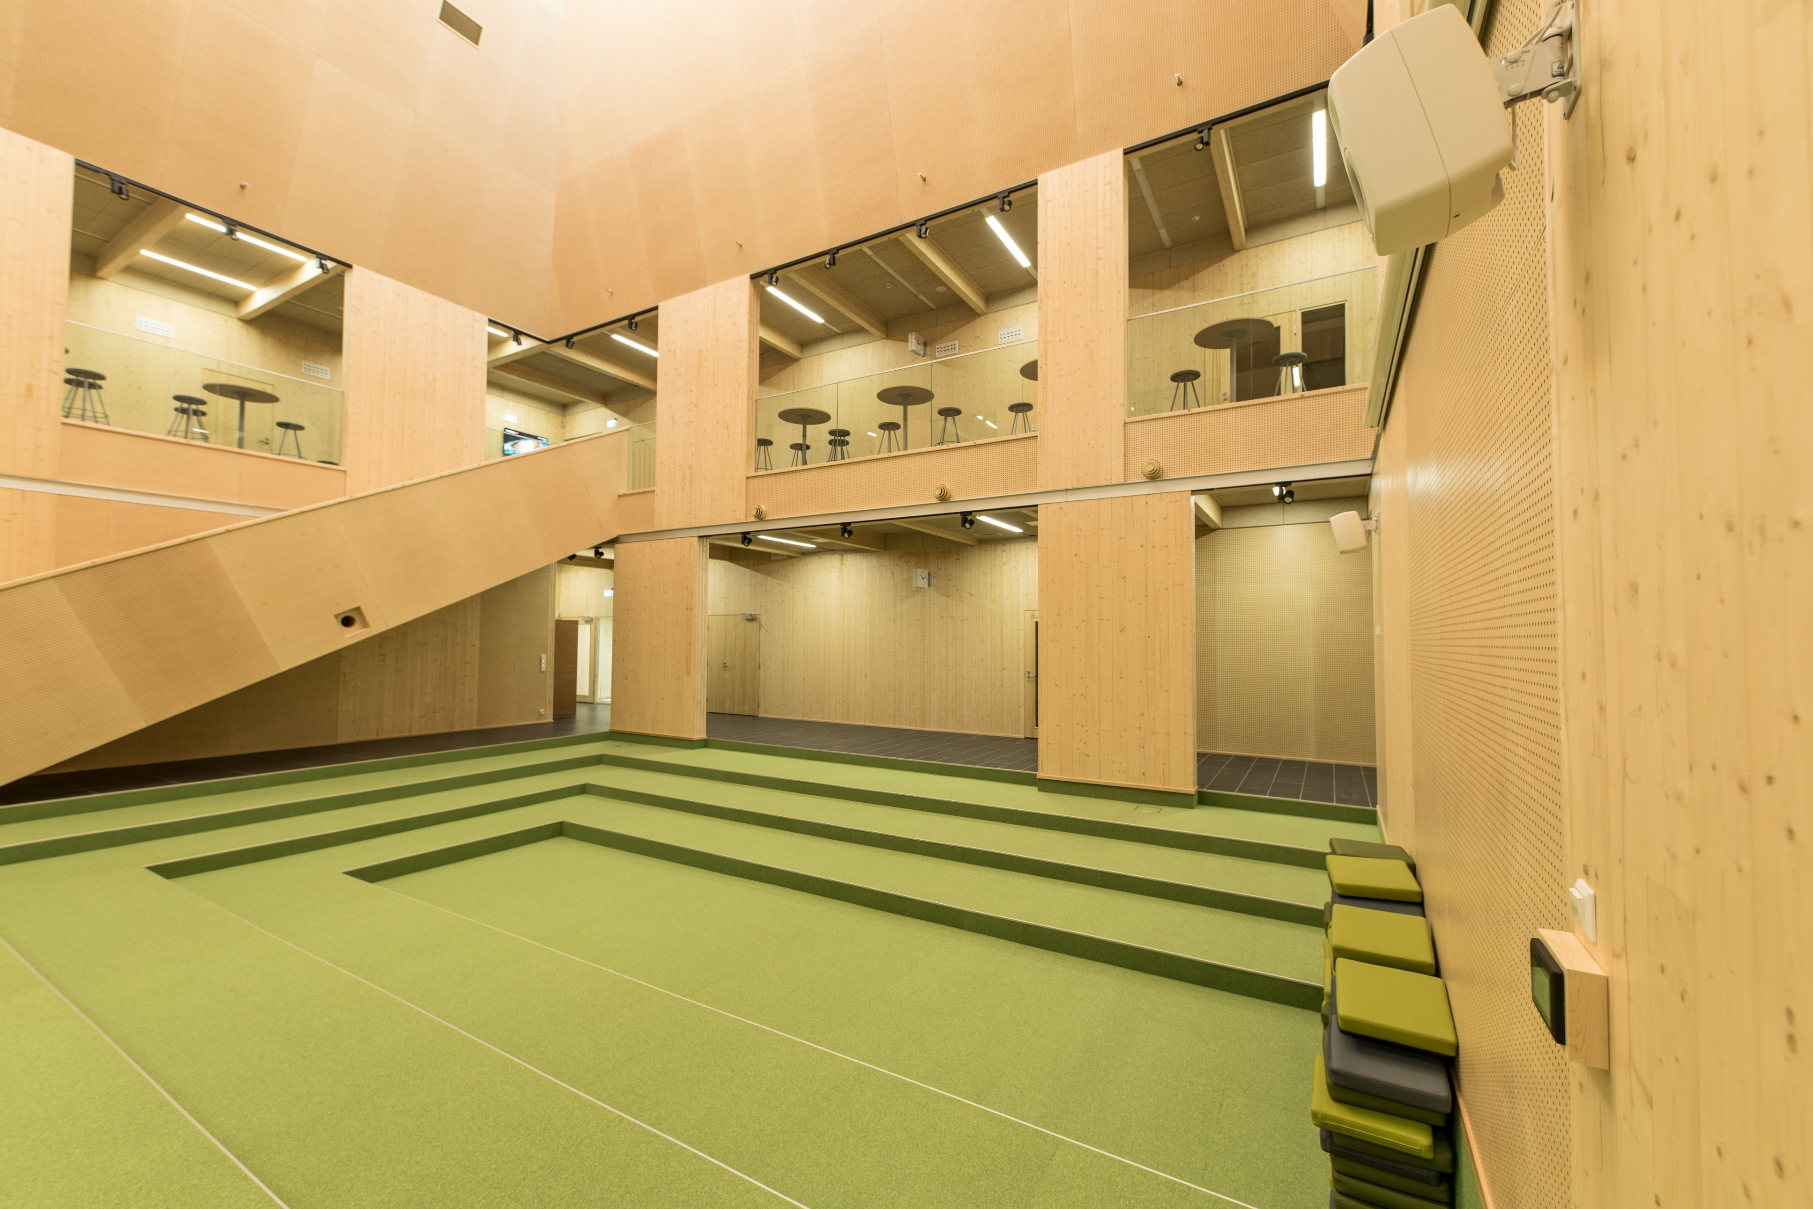
02-6/ LU2: TIMBER CONSTRUCTION, RENOVATION AND DECONSTRUCTION
RESTORATION, RECONSTRUCTION AND DISMANTLING

Slide 2
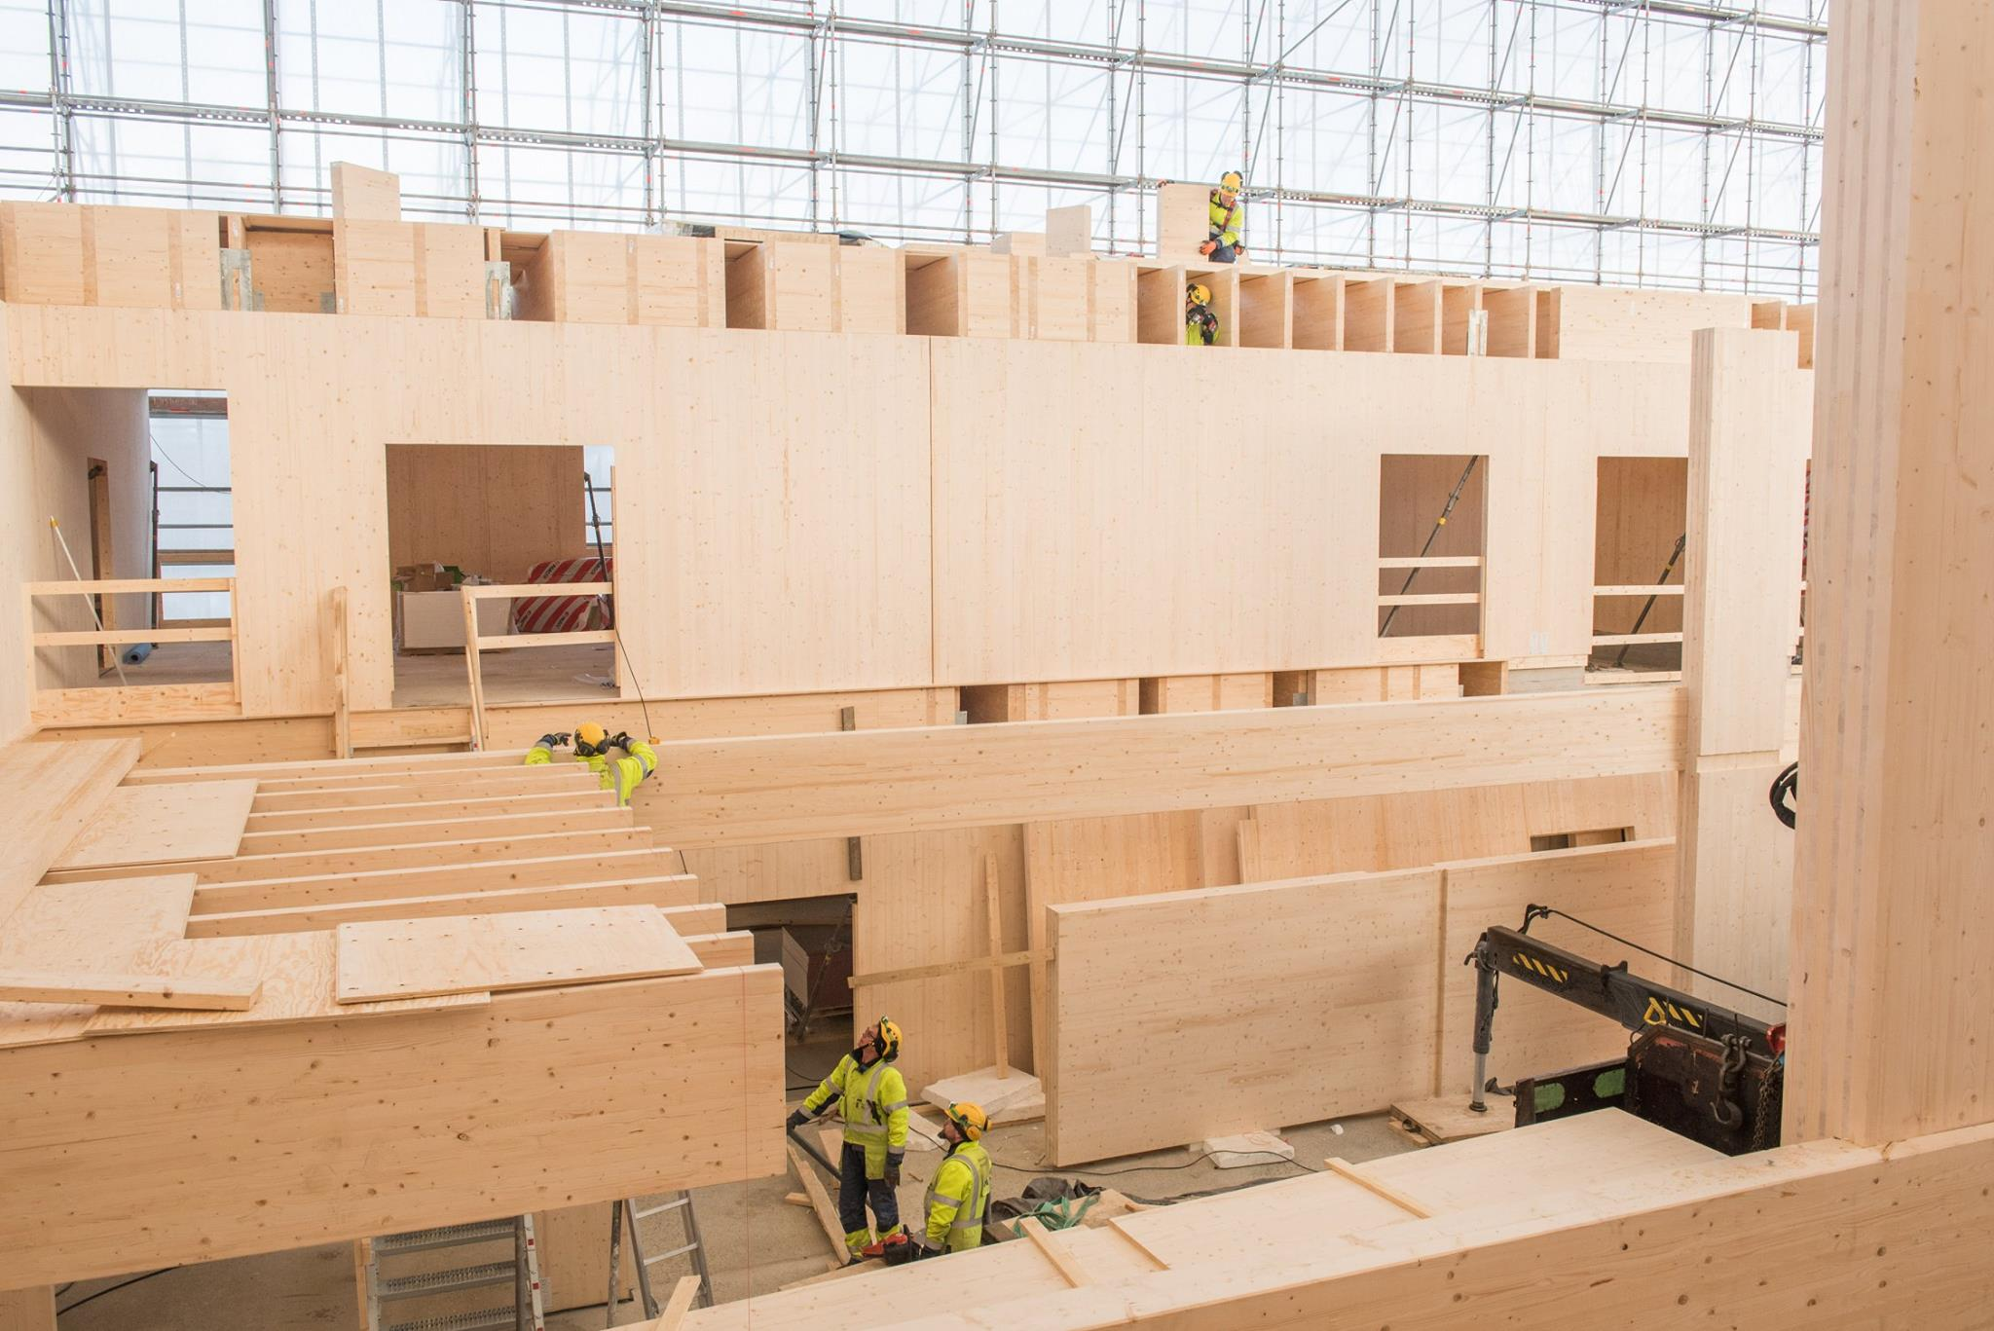
PRESENTATION OVERVIEW
Topics covered
- Terminology
Life cycle
Dismantling of building
Benefits
Frequently asked questions

Slide 3
Conservation: Correction of building defects by the measures of a conservation expert.
Repair: Repairing or replacing a defective structure, part, or appliance with a functional one, servicing it.
Renovation: The condition of a building is maintained or improved to better suit its purpose.
Maintenance: A maintenance activity in which the properties of an object are maintained by renewal.
Rehabilitation: The object is brought into a condition that is sufficient for use or preservation, for example.
Condition assessment: Determining the condition and repair needs of a property, building or part thereof.
Terminology
3

Slide 4
Renovation: Renovation construction to be carried out as a relatively large project.
Basic improvement: The quality level of the site will be raised substantially better than the original.
Reconstruction: Reconstruction of a building or part of a building based on preserved parts and / or documents.
Restoration: To maintain the antique and architectural values contained in the built environment or building.
Renewal: A measure in which an item or a significant number of its parts are replaced with new ones.
Annual renovation: A standard property renovation included in the annual budget. Repairs can be either predicted or unforeseen based on the condition assessment.
Terminology
4

Slide 5
Life Cycle Assessment (LCA) is a method of assessing the entire life cycle of a product or service, which consists of sourcing material from nature, handling and transporting the material, manufacturing, distribution, use, reuse, maintenance, recycling and disposal.
The life cycle of a wood product begins in the forest or on the farm where the tree grows.
Wood can withstand unprotected time and mechanical stress only if it stays dry.
The less wood has been treated, the easier it will be to find a new use.
The downside to recycling materials is that the quantity, quality and size of the material affect what can be made from the material.
Life cycle
5

Slide 6
Dismantling of building
If the building is protected under the Building Heritage Act or zoning regulations, or is potentially historically valuable, it is a good idea to contact the museum authorities at an early stage in the planning of the alterations.
The responsibilities and obligations of the person undertaking the construction and dismantling project are defined in the land use and construction legislation.
Waste sorting must be done practically throughout the dismantling work. It requires professionalism, workable tools and time. However, multi-stage demolition work and careful sorting are rewarded in waste management costs.
Asbestos surveying is mandatory in all buildings completed before 1994, including renovations. Asbestos demolition work is also strictly regulated.

Slide 7
Benefits
PRODUCTIVITY
EFFICIENCY
The degree of domestication of wood elements is high, the raw material, process industry and labor can be found in the target country.
The repair of wood material is effective because of the numerous restoration methods, as well as the fastening and joining techniques.
ENVIRONMENT
COSTS
Wood material binds carbon both during growth, but also when acting as a building material for a wooden structure. At the end of its life cycle, wood provides energy.
The costs of timber construction were higher than other construction, but as legislation, know-how and technology became possible for timber construction, the costs have decreased.

