Slide 1
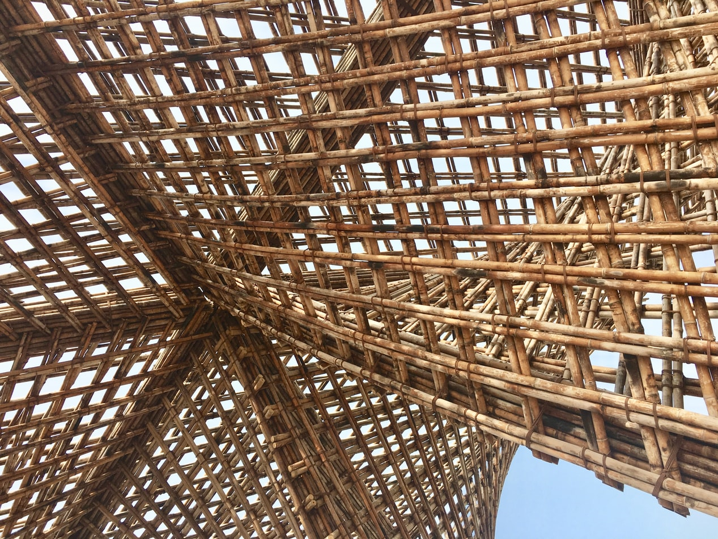
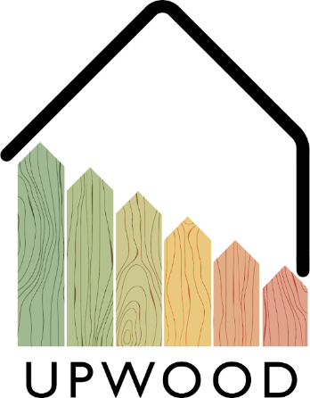
LEARNING UNIT 1:
Lesson 2
Possibilities of improving the properties of the wood and wood protection, durability

Slide 2
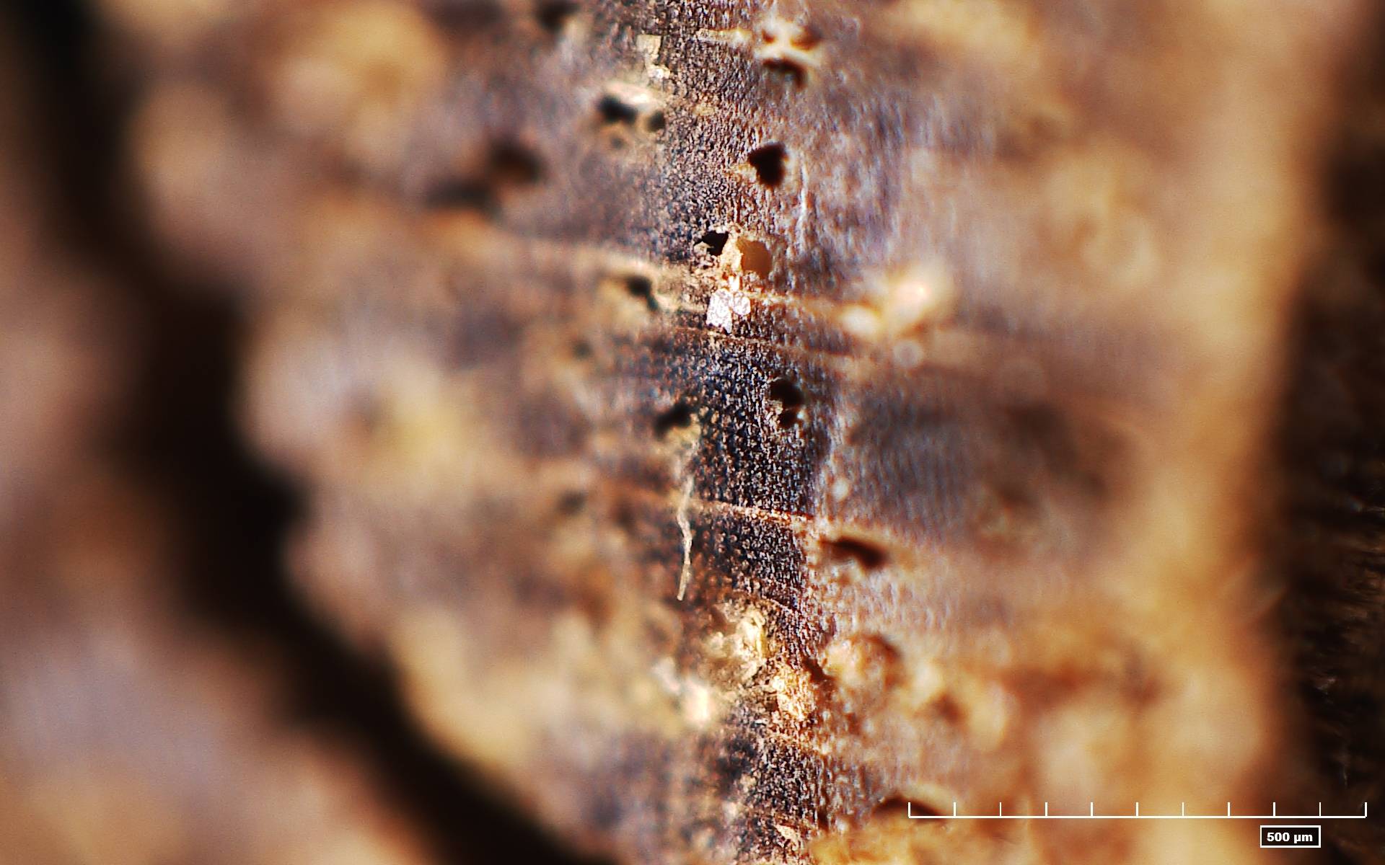
Presentation Overview
TOPICS DISCUSSED
Improvement of properties by appearance
Technological improvement of wood properties
Chemical improvement of wood properties
Thermal improvement of wood properties
Operational improvement of wood properties
Wood degrading microorganisms
LESSON 2: Possibilities of improving the properties of the wood and wood protection, durability

Slide 3
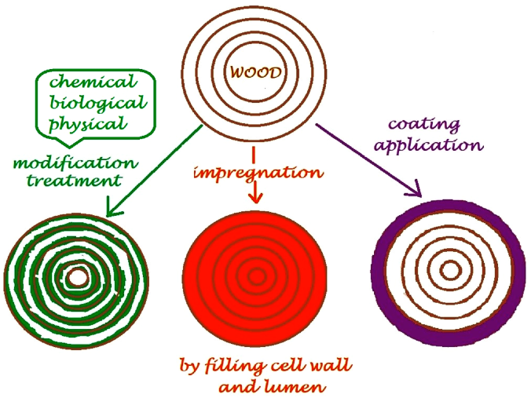
Some general things
IMPROVEMENTOF WOOD PROPERTIES
MODIFICATION (from Latin Modificatio), which indicates the determination of the correct measure (transformation of things, phenomena and processes).
IN GENERAL
The standard EN 350 (against wood-destroying fungi, dry wood-destroying beetles, termites and wood pests in sea water).
Wood (natural) durability classes:
Durability class 1 - highly durable
Durability class 2 - durable
Durability class 3 - moderately durable
Durability class 4 - slightly durable
Durability class 5 - non-durable.
Treatment is not to be confused with decorative or protective coatings – these are often recommended in addition to any chosen treatments.
Durability by wood species
Wood type | Heartwood | Sapwood
Fir | 4 | 5
Larch | 3-4 | 5
Spruce | 4 | 5
Pine | 3-4 | 5
European oak | 2-4 | 4
Teak | 1-3 | -
https://www.mdpi.com/2079-6412/10/7/629/htm
3
LESSON 2: Possibilities of improving the properties of the wood and wood protection, durability

Slide 4
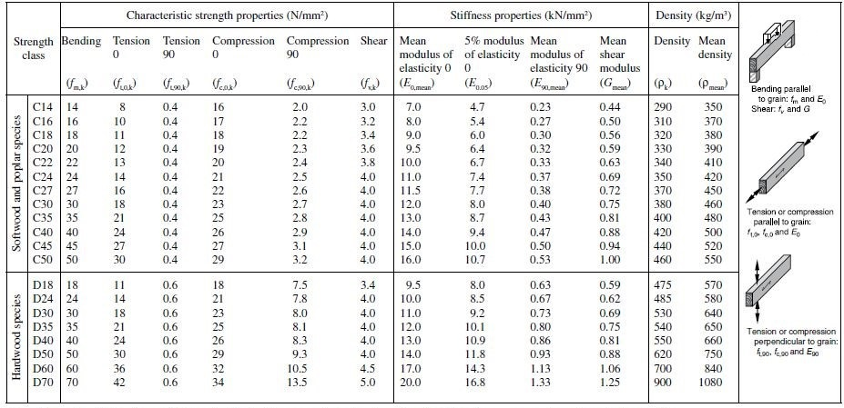
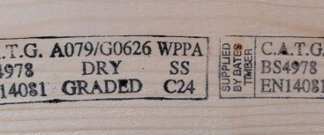
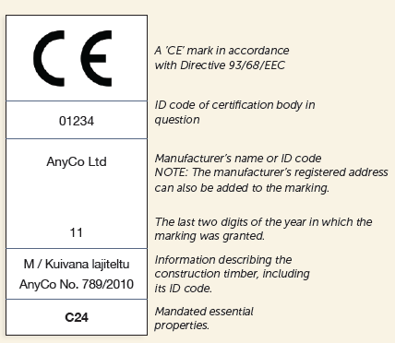
PINE
SPRUCE
IMPROVEMENTOF WOOD PROPERTIES
Visual grading can be done using special equipment:
System TM and Microtec
FinScan
Microtec Goldeneye 700
Application by grade class
Way of uses | US |  |  |  | V | VI | VII
 | US I | US II | US III | US IV
Stairs, other carpentry products | X | X | X | X
Window and doorframes (require painting) |  |  | X | X | X
Frame structure, roof trusses |  |  | X | X | X | X
Interior panels |  |  | X | X
Floors |  |  | X | X | X
Subfloor structures |  |  |  |  | X | X | X
Concrete moulds |  |  |  |  |  | X | X
BY APPEARANCE
Stress grading can be done:
mechanically
using sound velocity
visually
Stress grading classes
Marking
https://www.youtube.com/watch?v=NoFex15PE1Y
https://www.youtube.com/watch?v=iPoaGcyQ3us&feature=emb_logo
https://www.youtube.com/watch?v=qFwOcHbJats
Porteous J., Kermani A. Structural Timber Design to Eurocode 5 (Second edition)
https://www.youtube.com/watch?v=U1FyLa6Fm3M
www.youtube.com/watch?time_continue=25&v=zbpFLABn7cE&feature=emb_logo
https://www.youtube.com/watch?v=CfQ_60HuaTQ
4
LESSON 2: Possibilities of improving the properties of the wood and wood protection, durability

Slide 5
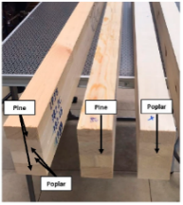
Sawn material size
Thickness, mm | Width, mm
 | 50 | 75 | 100 | 125 | 150 | 175 | 200 | 225 | 250
19^{1*} |  |  | X | O | O
22^{2*} | JH X | JH X | X | X | X | O | O
25^{1*} | O | O | X | O | O | O | O | O
32 |  | O | X | O | O | O | O | O
38 |  |  | X | X | O | O | O | O
44^{2*} |  |  | O | O | O | O | O | O | O
50 |  | JH X | X | X | X | X | X | O
63 |  |  | O | O | O | O | O | O
75 |  | JH O | O | O | O | O | X | X
100 |  |  | X | O | O | O | O | O
125 |  |  |  | X
150 |  |  |  |  | X
smooth planed surface
IMPROVEMENTOF WOOD PROPERTIES
rough planed surface
Size requirements
Dimension of timber | Max. permitted dimensional deviation for sawn-surface sawn timber | Max. permitted dimensional deviation for dimensioned timber
Thickness and width ≤ 100 mm | -1,0 to +3,0 | ±1,0
Thickness and width ≥ 100 mm | -2,0 to +4,0 | ±1,5
Length when sorted according to length | -25 to +50 | -25 to +50
Length when cut to the specified size | ±2,0 | ±2,0
BY TECHNOLOGICAL OPERATIONS
All around planned material size
Thickness, mm | Width, mm
 | 15 | 21 | 28 | 33 | 45 | 70 | 95 | 120 | 145 | 170 | 195
8 |  | X |  | X | X | X | X
12 |  |  |  | X | X | X | X
15^{1*} | X |  |  | X | X | X | X | X | X | O
18^{2*} |  |  |  |  | X | O | X | X | X | O | O
21^{1*} |  | X |  |  | X | X | X | X | X | X | X
28 |  |  | X |  | X |  | X | O | O
33 |  | O |  | X | X | X | X | O | O
45 |  |  |  | X | X | X | X | X | X | O | X
70 |  |  |  |  |  | X |  |  | O |  | O
All around planned material permitted size
Dimension | Dimensional deviation, mm
Thickness ≤ 20 mm | ±0,5
Thickness ≥ 20 mm^{1*} | ±1,0
Width ≤ 100 mm | ±1,0
Width ≥ 100 mm | ±1,5
Length when sorted according to length | -25 to +50
Length when cut to the specified size | ±2,0
https://www.woodproducts.fi/content/standard-sizes-thicknesses-widths-and-lengths
https://www.woodproducts.fi/content/permitted-dimensional-deviations
https://www.swedishwood.com/building-with-wood/about-glulam/choosing_glulam/
https://www.swedishwood.com/building-with-wood/about-glulam/choosing_glulam/
https://www.mdpi.com/1996-1944/13/14/3134/htm
https://iopscience.iop.org/article/10.1088/1757-899X/251/1/012104
5
LESSON 2: Possibilities of improving the properties of the wood and wood protection, durability

Slide 6
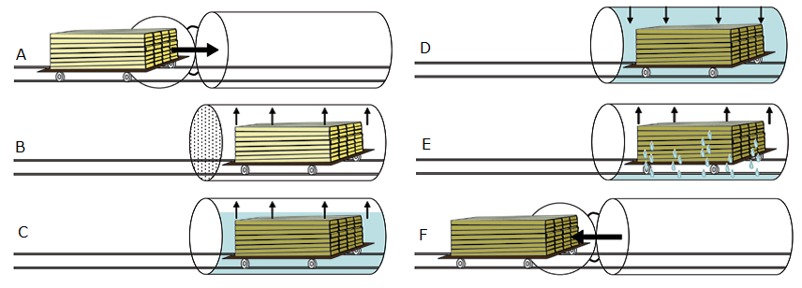
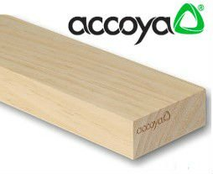
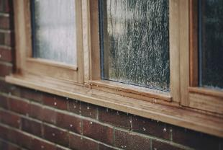
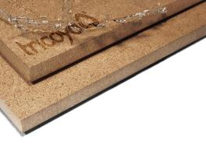
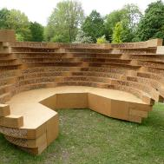
Classification of the treatability of wood
Treatability Class | Description^{1*} | Explanation
1 | Easy to treat | Easy to treat; sawn timber can be penetrated completely by pressure treatment.
2 | Moderately easy to treat | Fairly easy to treat; usually, complete penetration is not possible, but after 3 or 4 hours by pressure treatment more than 6 mm lateral penetration can be reached in softwoods and in hardwoods a large proportion of the vessels will be penetrated.
3 | Difficult to treat | Difficult to treat; 3 – 4 hours by pressure treatment may not result in more than 3 mm to 6 mm lateral penetration.
4 | Extremely difficult to treat | Virtually impervious to treatment; little preservative absorbed even after 3 – 4 hours by pressure treatment; both lateral and longitudinal penetration minimal.
IMPROVEMENTOF WOOD PROPERTIES
Treatability classes by wood species
Wood type (softwoods) | Heartwood | Sapwood
Douglas fir | 3-4 | 2-3
Fir | 2-3 | 2
Pine | 3 | 1
Spruce | 3-4 | 3
There are two types of chemical protection:
preventive - to prevent or modify wood in the conditions of prolonged wetting its resistance to wood damages;
corrective - to actively control damages that have already been introduced into the wood.
CHEMICAL
A – untreated wood is placed in cylinder; B - a vacuum is applied; C - the wood is immersed in solution (still under vacuum); D - pressure is applied; E - preservative is pumped out, and a final vacuum; F - the wood is removed from the cylinder.
Some products
Basic requirements for wood preservatives – must:
be toxic to fungi, insects and marine organisms;
not have any undesirable properties during use;
not be corrosive;
be cheap.
Acetylated wood Accoya®
Acetylated fiberboard Triccoya®
https://www.accoya.com/uk/
https://tricoya.com/
Wood Hanbook, 2010
EN 350:2016 Durability of wood and wood-based products – Testing and classification of the durability to biological agents of wood and wood-based materials
6
LESSON 2: Possibilities of improving the properties of the wood and wood protection, durability

Slide 7
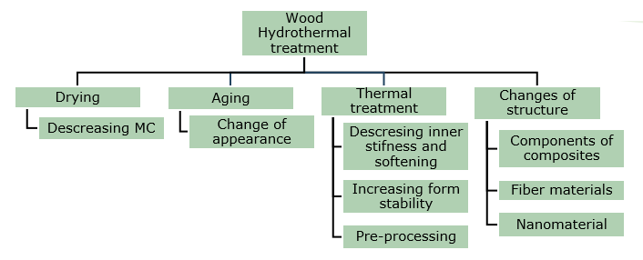
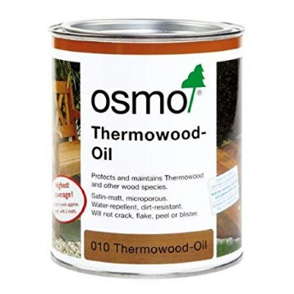
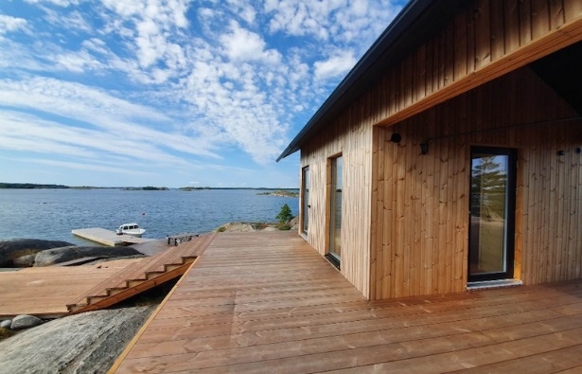
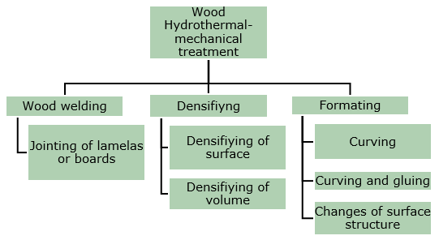
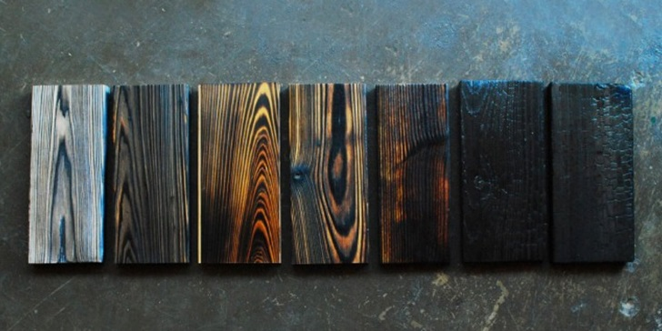
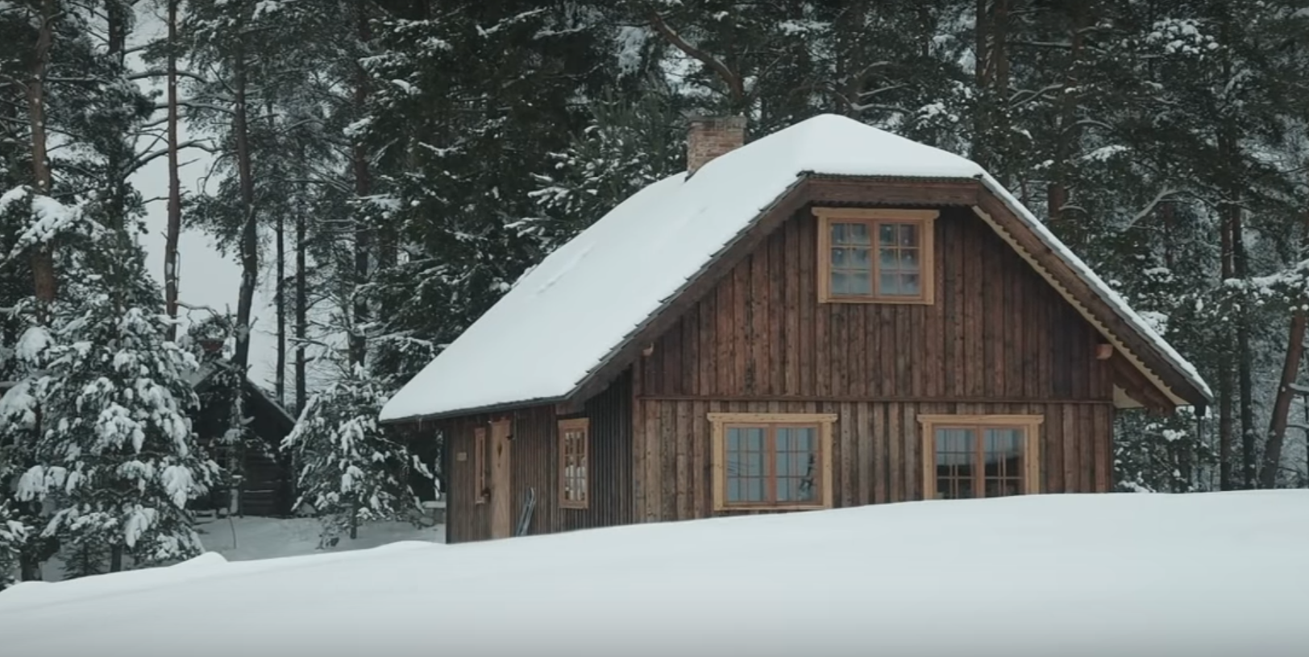
IMPROVEMENTOF WOOD PROPERTIES
Process | Temperature of modification, °C | Time of process, h | WTM environment | WTM happens
FWD | 120–180 | 12–15 | Heat | Closed system
Plato | 150–190 | 70–120 | Saturated steam and after then heated air | A four-step process
ThermoWood | 185–215 | 30–70 | Steam flow | In an open system
Le Bois Perdure | 200–230 | 12–36 | Heat | In an open system
Retification | 160–240 | 8–24 | N or other inert gas flow, 0₂ content ≤ 2% | In an open system
OHT | 180–220 | 24–36 | Vegetable oil | Closed system
TERMOVUOTO | 160–220 | ≤ 25 | Vacuum | In an open system
THERMAL
Shou-sugi-ban method
(click on the picture)
https://greenglobe.com/innovations/lunawood-thermowood/
https://wc-studio.com/journal/shou-sugi-ban
https://pioneermillworks.com/product/shou-sugi-ban-larch-shallow-char
7
LESSON 2: Possibilities of improving the properties of the wood and wood protection, durability

Slide 8
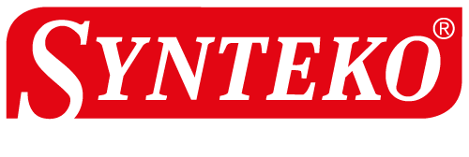
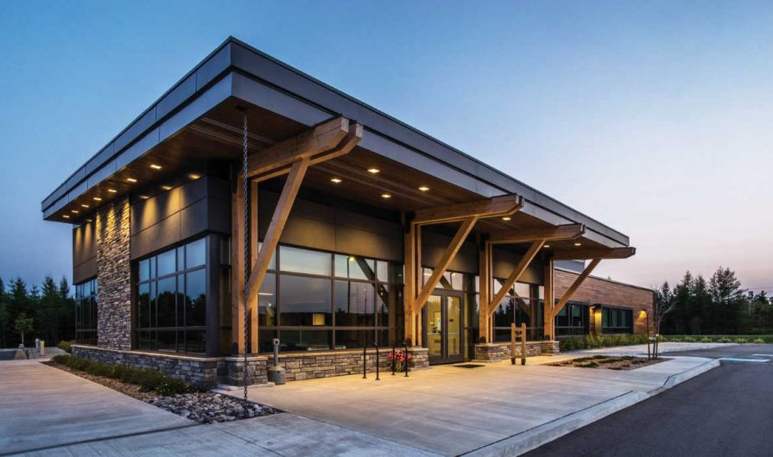
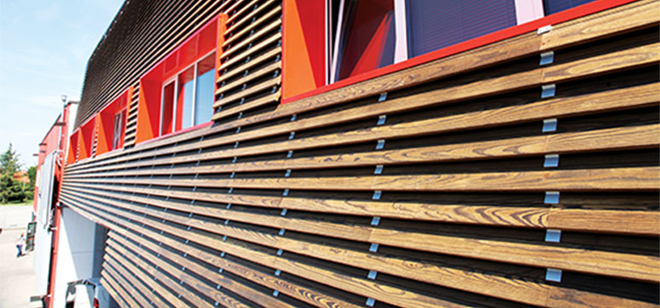
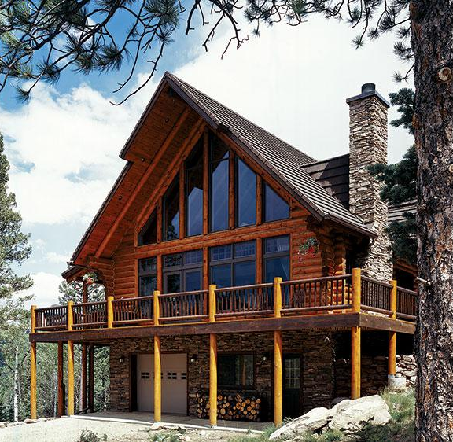
Protection by surface covering
Lazurs are transparent coatings with open pores. If they contain light resistant pigments fine, solid particles finely dispersed in a binder and solvent, then simultaneously on the surface protects against both moisture and ultraviolet radiation and at the same time allows wood to evaporate excess moisture. Lazurs are based on organic solvents or water. Varnishes are solutions of film-forming organic substances to improve the surface properties of materials (improvement of appearance, protection against humidity and weathering).
Oils and waxes first protect the wood surface from physical exposure, such as stains, dirt, dust and scratches.
IMPROVEMENTOF WOOD PROPERTIES
Some producers (click on the logo)
OPERATIONAL
Protection by structure covering
Constructive measures to be taken during the design of the building are:
wide roof overhangs to protect wooden walls from direct rain;
properly designed cladding that facilitates water drainage and under which ventilation is provided;
high foundations (at least 50 cm above ground level) to prevent wood from getting wet with bounced water drops.
http://www.wooddesignandbuilding.com/moisture-wood-frame-buildings/
https://www.loghome.com/articles/log-home-foundations
https://wfmmedia.com/cladding-choices/
8
LESSON 2: Possibilities of improving the properties of the wood and wood protection, durability

Slide 9
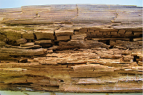
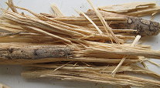
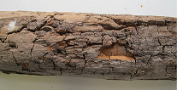
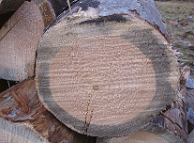
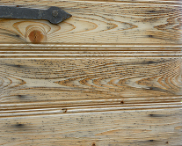
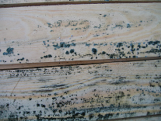
Wood fungi
Limitations:
Wood degradation microorganisms - fungi
Brown rot
White rot
Soft rot
Wood coloring fungi
Primary blue stain
Secondary blue stain
Mold
Mold on a wet wood surface
Probable Strength of Wood in Early Stage of Decay (5 to 10%)
Strength property | Probable Remaining strength (% of original strength)
Static bending | 30
Impact bending | 20
Modulus of Elasticity | 30
Compression parallel to grain | 55
Tension parallel to grain | 40
Compression perpendicular to grain | 40
Shear | 80
LESSON 2: Possibilities of improving the properties of the wood and wood protection, durability

Slide 10
Benefits
WOOD SPECIES
EFFICIENCY
Some of the wood species are naturally durable (Aspen, Teak etc.)
Wood materials should be protected for prolonging longevity
INDUSTRIAL APPLICATIONS
ENVIRONMENT FRIENDLY
Not always necessary – can be done at home, e.g. repainting
More and more varnishes, paints are become eco-friendly of water based solutions
LESSON 2: Possibilities of improving the properties of the wood and wood protection, durability

Slide 11
QUESTIONS AND ANSWERS
Which tree species are biologically resistant?
A: Larch, Oak, Teak e.g.
2. What substances are used to protect wood industrially?
A: preservatives
3. What substances are used to protect wood manually?
A: paints, varnishes, oil, waxes etc.
4. What are the main 2 methods of chemical protection of wood?
A: preventive and corrective
5. What does wood modification improve?
A: The stability of the wood dimensions and biological stability
6. What does wood modification decrease?
A: It reduces moisture uptake and renders it unusable for bio-degraders.
7. Please, name at least 3 improvement methods of wood properties?
A: chemical, thermal, operational, by appearance, technological
8. What substance forms brown colour in wood at the time of thermal modification?
A: Lignin
9. The wood-destroying agents considered to standard are?
A: wood-decaying fungi; beetles capable of attacking dry wood; termites; marine organisms capable of attacking wood in service
10. Please, characterize planed sawn material surface:
A: smooth planed and rough planed
11. What can be end sizes of cross section of the planned wood materials if the sizes before planning was: thickness 100 mm and width 200 mm?
A: Thickness 95 mm and width 195 mm.
11
LESSON 2: Possibilities of improving the properties of the wood and wood protection, durability

Slide 12
References
EN 335:2013 Durability of wood and wood-based products – Use classes: definitions, application to solid wood and wood-based products
EN 350:2016 Durability of wood and wood-based products – Testing and classification of the durability to biological agents of wood and wood-based materials
EN 975-1:2009 Sawn timber - Appearance grading of hardwoods - Part 1: Oak and beech is used.
EN 1912 "Structural Timber. Strength classes. Assignment of visual grades and species"
Hill C.A.S. Wood Modification. Chichester: John Wiley & Sons, Ltd, 2006. 239 p.
Hoadley R.B. Understanding Wood: A Craftsman's Guide to Wood Technology. The Taunton Press, 2000. 288 p.
Porteous J., Kermani A. Structural Timber Design to Eurocode 5 (Second edition). 2013., Willey-Blackwell, 640 p.
Porter T. Wood identification and Use. GMC Publications, 2007., 288 p.
Rowell R.M. Handbook of wood chemistry and wood composites. London: Taylor&Francis group, London, 2005. 487 p.
Niemz P. and Sonderegger W. U. Holzphysik: Physik des Holzes und der Holzwerkstoffe. Carl Hanser Verlag GmbH & Co. 2017., 580 p.
Morozovs A., Irbe I., Bukšāns E. Chemical processing and protection of wood (Koksnes ķīmiskā pārstrāde un aizsardzība. In Latvian) Avots, Rīga, 2018., 171 p.
Sandberg D., and Kutnar A. Thermally modified timber: recent developments in Europe and North America. Wood and Fiber Science 48(1), 2016., 28-39 pp.Wagenführ A. Scholz F. Taschenbuch der Holztechnik. Carl Hanser Verlag GmbH & Co. 2018., 567 p.
JOURNALS AND PUBLICATIONS
12
LESSON 2: Possibilities of improving the properties of the wood and wood protection, durability

