Slide 1
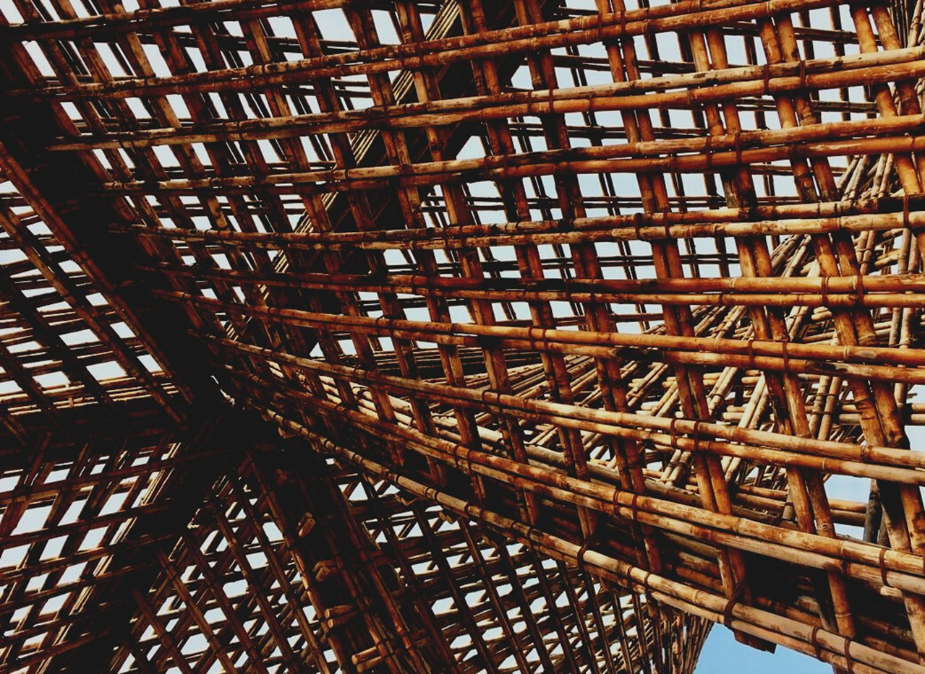
LEARNING UNIT 3: On-site wood construction assembling management.
Lesson 4:
Architectural design – drawings and schemes.
Presentation

Slide 2
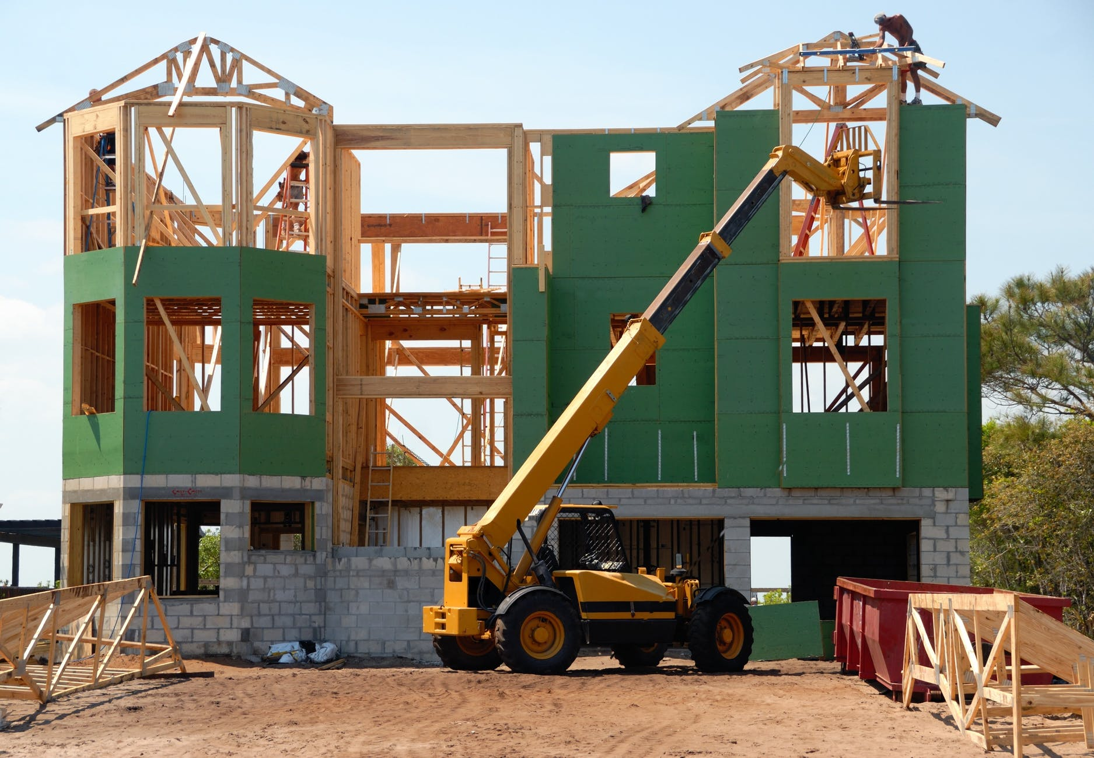
Presentation Overview
TOPICS DISCUSSED
- Building Design process
LESSON 4: Architectural design – drawings and schemes.

Slide 3
BUILDING DESIGN
The concept of Building Design refers generally to the representation of elements related to architecture and engineer. Usually, the one the make the design is an architect in charge of representing the building trades, being able to reach the specific needs, there are five steps leading to the final design of a building. The schematic design is the first phase of the work, the architect speaks with the client and establish the requirements and objectives of the project.
3
LESSON 4: Architectural design – drawings and schemes.

Slide 4
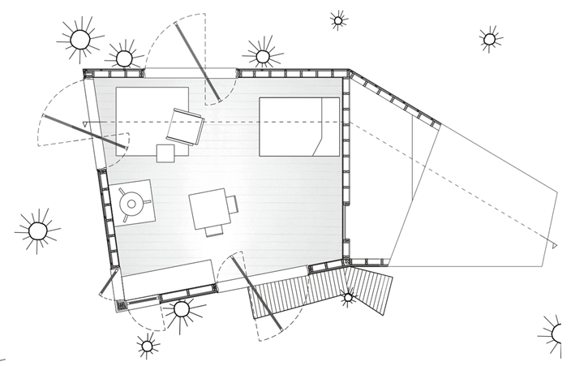
Process
After the schematic design, there is the proper design phase, with a resume of all the data collected in the previous steps. The process analyses materials, positions of holes and general structural details. Reached this part of the design, when architect and client are comfortable with all the process carried out, constructive documents can be filled.
LESSON 4: Architectural design – drawings and schemes.

Slide 5
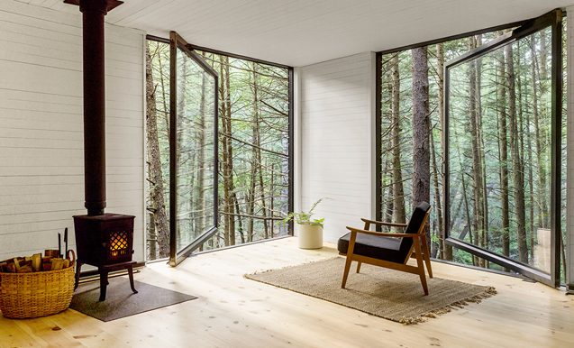
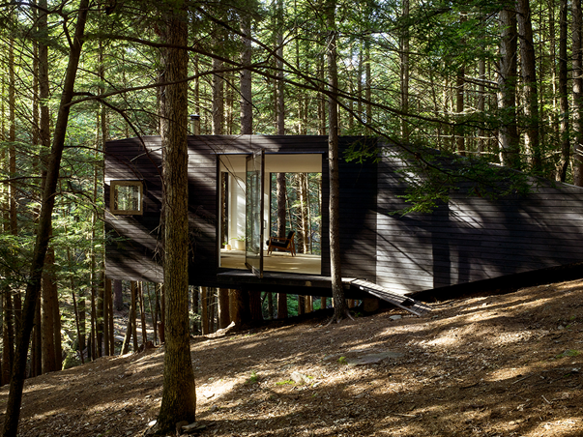
Process
Designs now are much more detailed and are used for the construction phase and the final decisions on materials. When this part is completed, the design is sent to contractors for price reports and to the construction department for construction licences. Depending on the type of projects, a negotiation phase is required. The last phase is the construction, thanks to the building design, it is possible to achieve the complete realization of the finish proposal.
Half Tree House-Jacobs Chung
LESSON 4: Architectural design – drawings and schemes.

