Slide 1
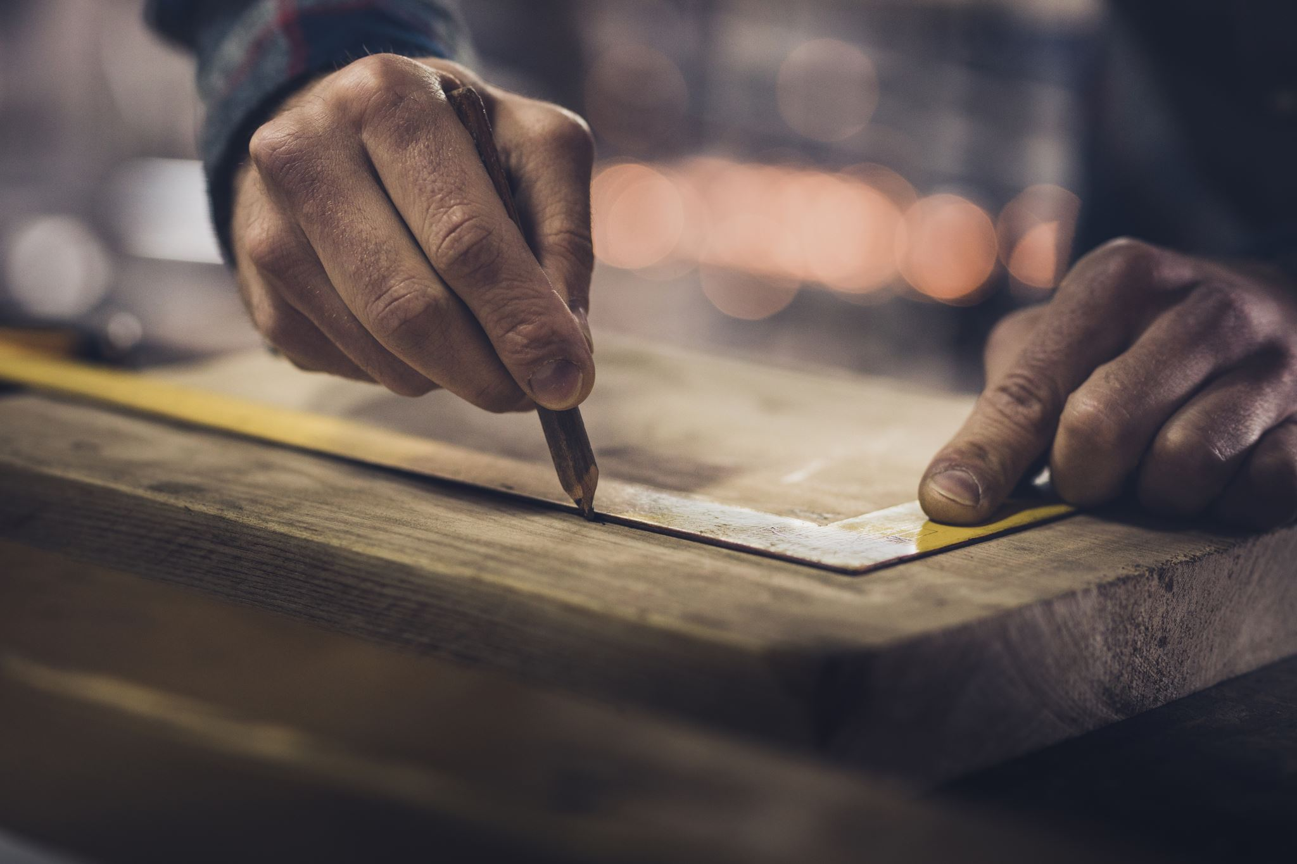
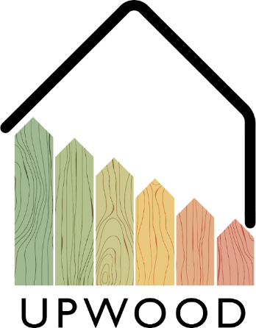
03-2/ LU2: TIMBER CONSTRUCTION, RENOVATION AND DECONSTRUCTION
GENERAL INSTRUCTIONS FOR THE USE OF WOOD MATERIAL

Slide 2
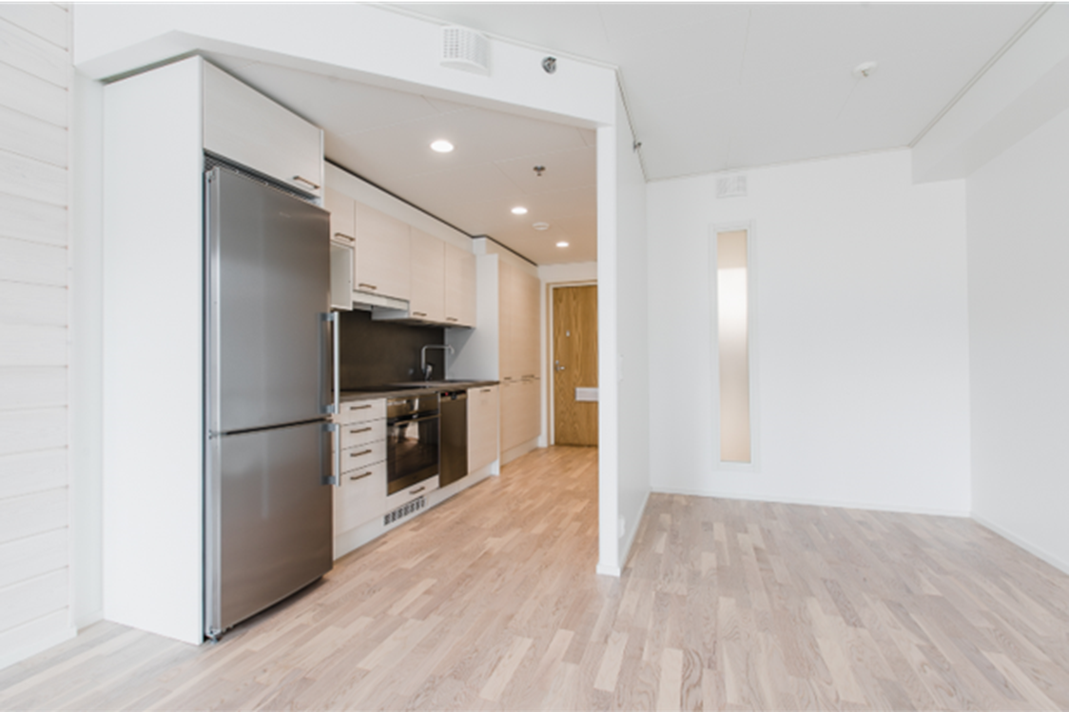
PRESENTATION OVERVIEW
Topics covered
Terms
CE marking
Sawn timber applications
Building components
The use of wood material in construction
Storage and handling
Frequently asked questions

Slide 3
Terms
Timber: Common name for sawmill and planing mill products as well as round wood.
Sawn timber: A general term for sawn on all sides for timber.
Planed timber: General term on at least three pages for planed timber.
Glulam: A further processed piece of lumber that is manufactured by gluing at least four lamellae, not more than 45 mm thick.
Laminated Veneer Lumber (LVL): A wood product made by gluing at least five veneers up to 6 mm thick.
3

Slide 4
CE marking
Market surveillance of construction products ensures that there are only CE-marked construction products in the European internal market that meet the requirements set for them.
The CE marking is the conformity marking, which demonstrates that the construction product complies with the relevant harmonized product standard and meets the essential safety and health requirements of the Construction Products Directive.
A CE marked construction product can be exported and sold freely in the European internal market.
4

Slide 5
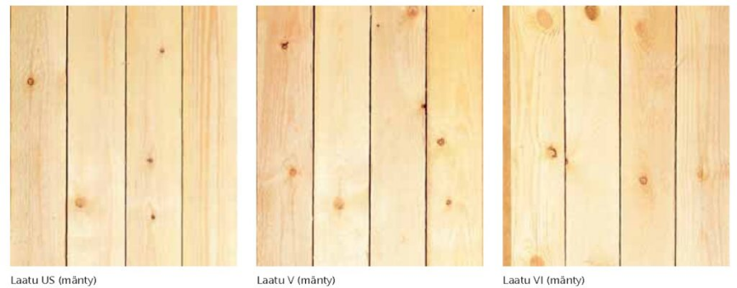
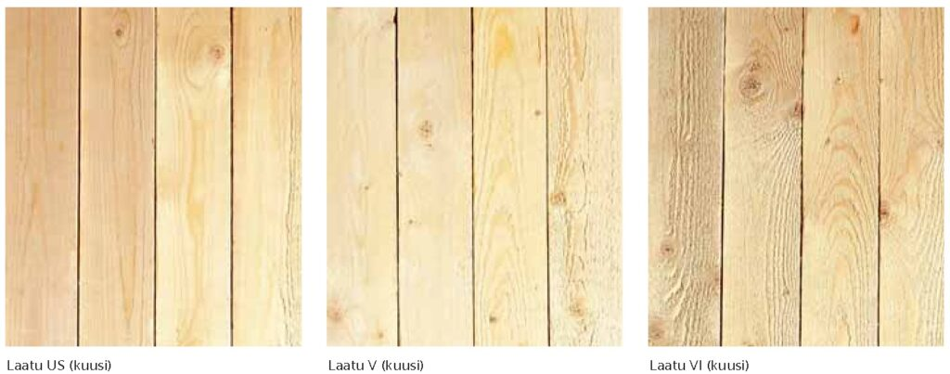
Sawn timber applications
Window and door industry: Pine heartwood has an inherent resistance to rot fungi, so it withstands weather conditions better without special treatments and guarantees a longer life cycle for the wood product in weathering.
Furniture industry: Both pine and spruce logs with healthy branches or branchless base tops are very common raw materials for the visible surfaces of solid wood furniture.
Planed timber: Timber sorted for different applications (US I, US II, US III, US IV, V, VI and VII), where the buyer has determined e.g., branch size, edging and straightness.
Log industry: The log industry uses wood sawn from intermediate supports in hidden parts and heart-sawn wood in visible surfaces. The log material of the handcrafted building is solid wood, but the industrial log industry glues the log blank to be machined from several cores.
Wooden trusses: The truss industry uses only planed strength-graded wood material.
5

Slide 6
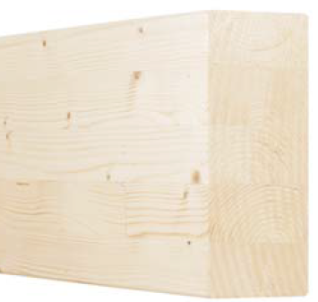
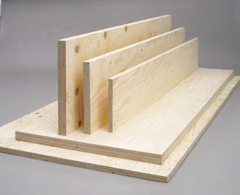
Building components
The building components are glued wood products EWP (Engineered Wood Product). The more common EWP products are glulam, Veneer and I-beams.
Glulam: Glulam in this context means horizontal glulam for load-bearing structures in accordance with standard SFS-EN 14080 and manufactured in accordance with standard SFS-EN 386. In addition, the glulam to be treated in this context consists of a minimum of four and a maximum of 45 mm thick sawn timber lamellas, the grain direction of which is in the longitudinal direction of the glulam product.
Laminated Veneer Lumber: Laminated Veneer Lumber in this context means veneer for load-bearing structures that complies with standard SFS-EN 14374. Finnish Veneer is made by gluing 3 mm thick spruce veneers so that the grain direction of the veneers is in the longitudinal direction of the veneer product.
I-beams: Usually, such products are manufactured according to a separate plan, but I-beams, for example, are also available by the meter.

Slide 7
The use of wood material in construction
PRODUCTIVITY
EFFICINECY
The wood material is a light, yet strong compared to its weight, material that can be joined in many different ways.
Preforms made of wood are quick to attach and basic tools and fasteners can be used for attachment.
ENVIRONMENT
COSTS
The lifespan of a wood material in a well-protected structure can be hundreds of years, and the end-of-life gun is recyclable.
Preparations made from wood raw material are inexpensive to transport, they can be processed with basic tools. Waste generated during processing is recyclable.

Slide 8
Storage and handling
At the construction site, the timber must always be stored on a dry, stable and level surface so that the timber is removed from the ground and no harmful deformations and defects detrimental to the appearance of the timber can occur.
The goods must be covered in such a way that they are protected from rain and snow.
Timber storage should always be done in such a way that the humidity conditions during storage correspond as closely as possible to the final humidity conditions of the timber at the place of use.
The instructions given by the product manufacturer must be followed when storing timber for interior cladding structures, when removing protective plastics and when ventilating the product.
8

Slide 9
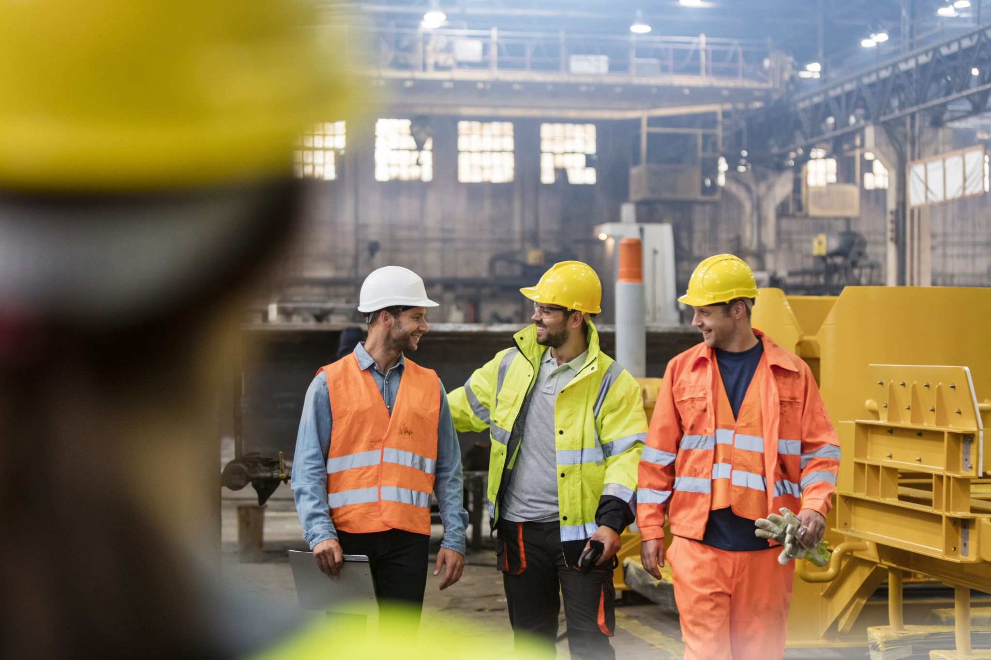
What is the difference between quality and strength classification?
The quality class is determined by the appearance of the sawn wood and the strength class by the properties related to the strength of the wood, which often also affect the appearance.
What is typical for an engineered LVL product?
Laminated Veneer Lumber in this context means veneer for load-bearing structures that complies with standard SFS-EN 14374.
Frequently asked questions
TYÖTURVALLISUUS JA ERGONOMIA

