Slide 1
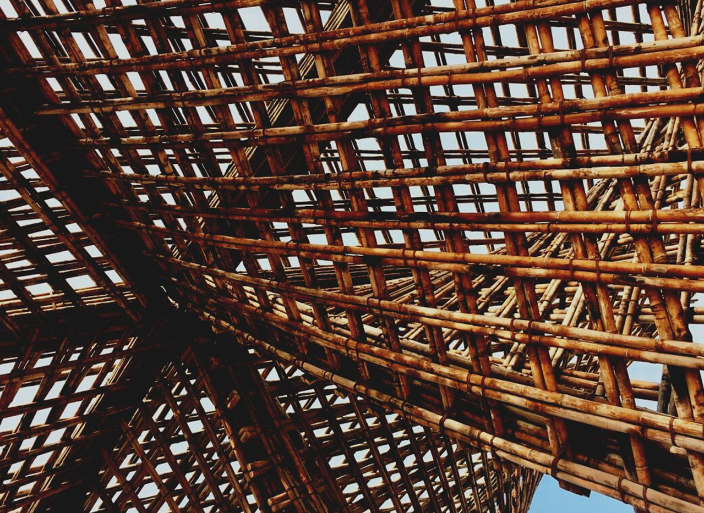
02-1/ LU3: ON-SITE WOOD CONSTRUCTION ASSEMBLING MANAGEMENT
WORK PLANNING AND TEAM MANAGEMENT

Slide 2
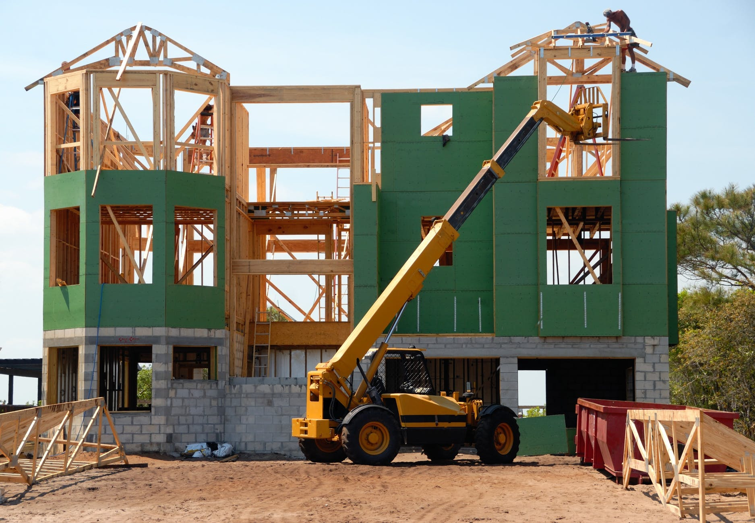
PRESENTATION OVERVIEW
Topics covered
Introduction
Work management
The benefits of good management
Frequently asked questions

Slide 3
Introduction
The person undertaking the construction project must lead and direct the project as a whole, which takes into account both the project planning, procurement and the time needs required for the construction phases.
Right at the beginning of the project, an agreement is reached on how the content of the design will be produced, controlling quality and schedule.
Today's data modeled projects determine data modeling practices to the extent that the modeled data and information are available to the project, e.g., in calculation, prefabrication, construction and supervision.
3

Slide 4
Work management
Management is:
Leading people
Work management
Team network management
Scheduling
Case management:
Design management
Material flows
Electronic database
Incoming data management and storage
4

Slide 5
The benefits of good management
PRODUCTIVITY
EFFICIENCY
With good planning, future problem situations can be minimized, and management can make the project rhythmic at the right time with the right size resources.
Some of the work is done in advance as pre-preparations, and dismantling and re-making is reduced.
ENVIRONMENT
COSTS
Good planning and management reduce material loss, which reduces the amount of waste generated on site.
Costs are reduced with less storage requirements, less material waste and increased work efficiency.

